Slide 1
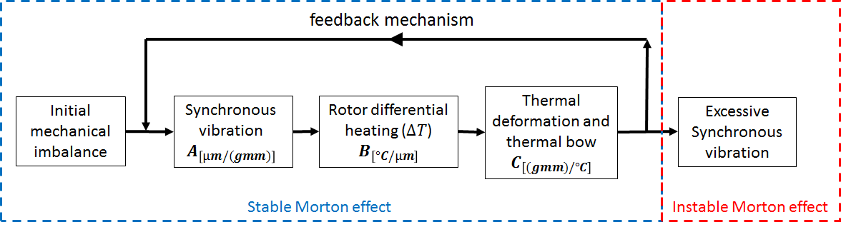






$$U_{m}, Z^{0}, {\dot{Z}}^{0} ,T_{rotor}^{0},T_{pad}^{0}$$
$F_{imbalance}$ = centrifugal force ($U_{m}, U_{ther}, t_{dynamic})$
$F_{brg}$ = Generalized Reynolds Equation($Z, \dot{Z},t_{dynamic}$)
$q_{rotor}^{n},q_{pad}^{n}$ = 3D energy equation($T_{rotor}^{n},T_{pad}^{n})$
$$M\ddot{Z}=F_{brg}+F_{imbalance}+F_{gravity}$$ Newmark-beta algorithme
No
Convergence of orbit
(shooting method)
Yes
${q_{avg}}_{rotor}^{n}$= time-averaging approach of heat flux
$$t_{n+1}=t_{n}+ ∆t_{thermal} \left(∆t_{thermal}=100T_{period}\right)$$
$T_{rotor}^{n+1}, T_{pad}^{n+1}$ = transient heat condunction model (${q_{avg}}_{rotor}^{n}$, ${q_{avg}}_{pad}^{n}$, $t_{n}$)
$U_{ther}^{n+1}$ = computation of the thermal imbalance ($T_{rotor}^{n+1}$)
$$t_{n+1}≤t_{end}$$
Yes
$$End$$
No

Slide 2
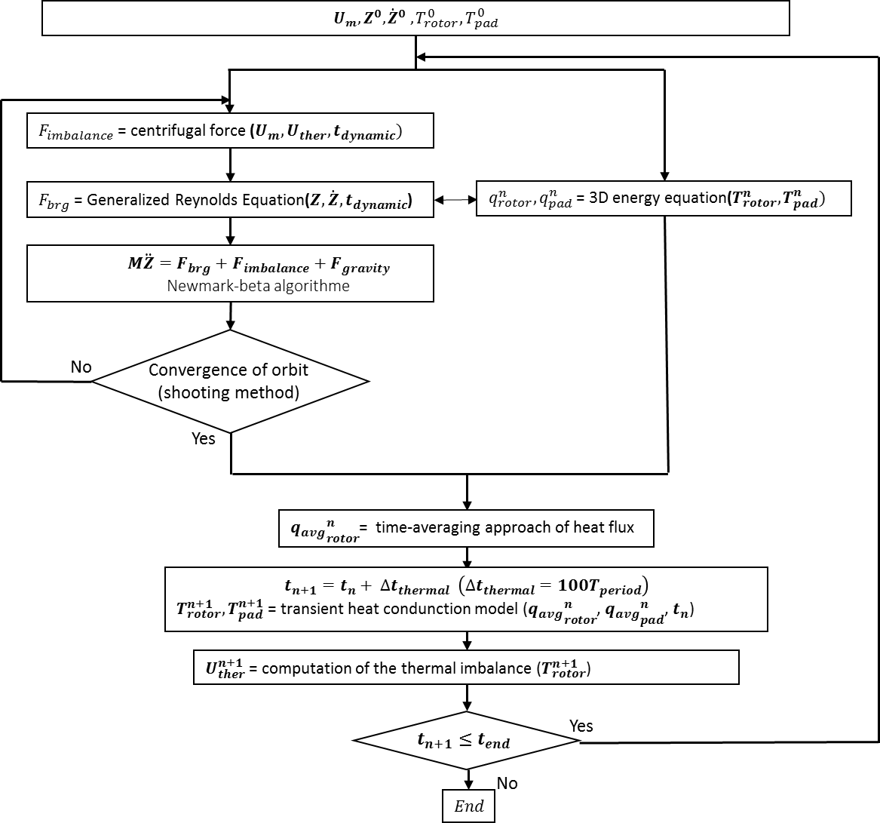



Synchronous vibration
$$A_{\left[µm/(gmm)\right]}$$
Rotor differential heating ($∆T$)
$$B_{\left[°C/µm\right]}$$
thermal imbalance
$$C_{\left[(gmm)/°C\right]}$$

Slide 3
